Slide 1
Predictive Model App
Brittany Roberts

Slide 2
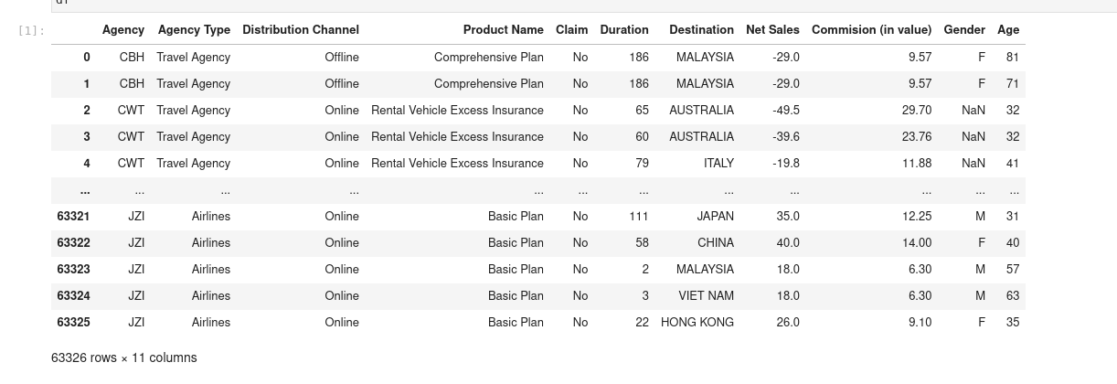
Goal of App
For this app, we are looking to predict if a client will make a claim on their travel insurance policy based on the data show in Figure 1.
Figure 1

Slide 3
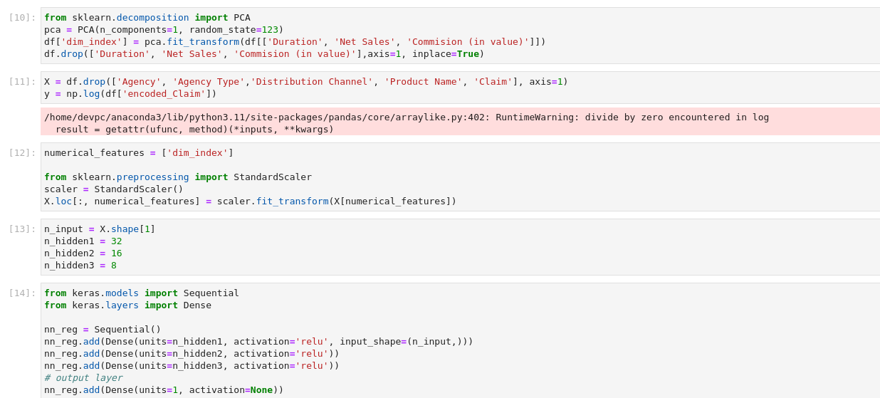
Model Creation
After data cleansing and preprocessing, we started with the code in Figure 2 to create the model for the app.
Use a PCA to help find the best numerical component to help predict the outcome. Then used the Standard Scaler on the same data to standardized the numerical data.

Slide 4
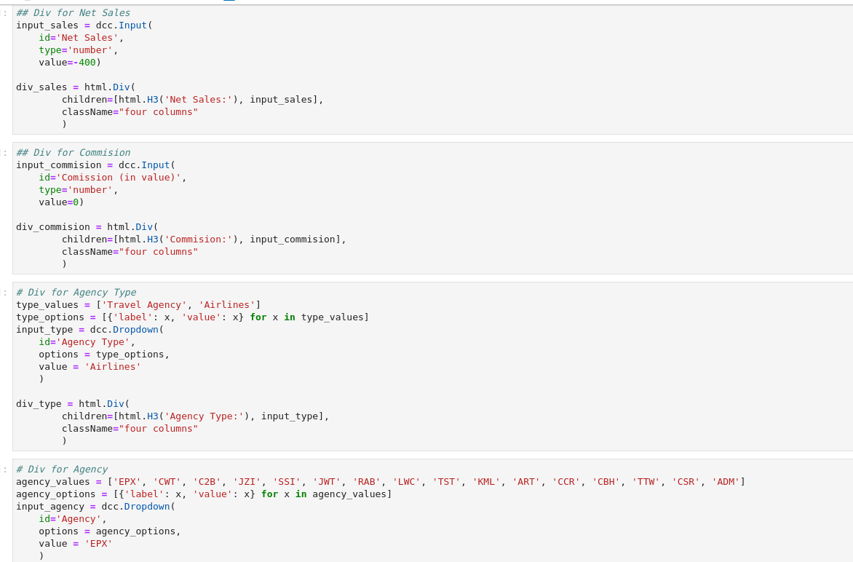
App Creation
To create the parts that the client inputs information, we used the code in Figure 3for both numerical and categorical input.
Figure 3

Slide 5
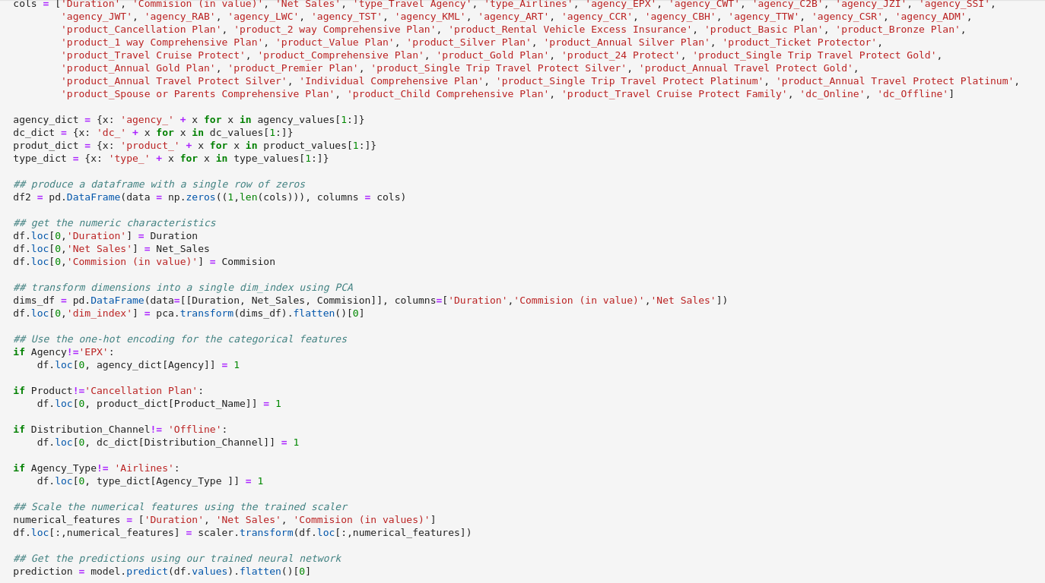
Implementation of Model in App
To implement the model in the app, we used the code in Figure 4.

Slide 6
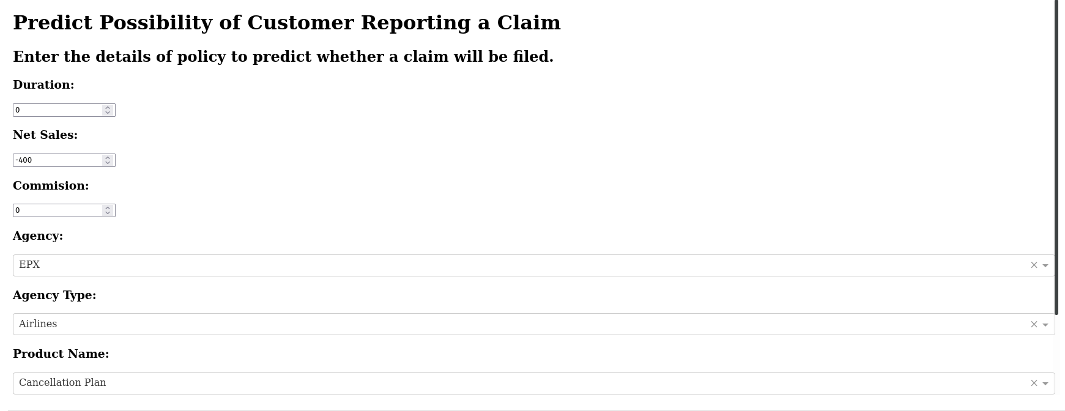
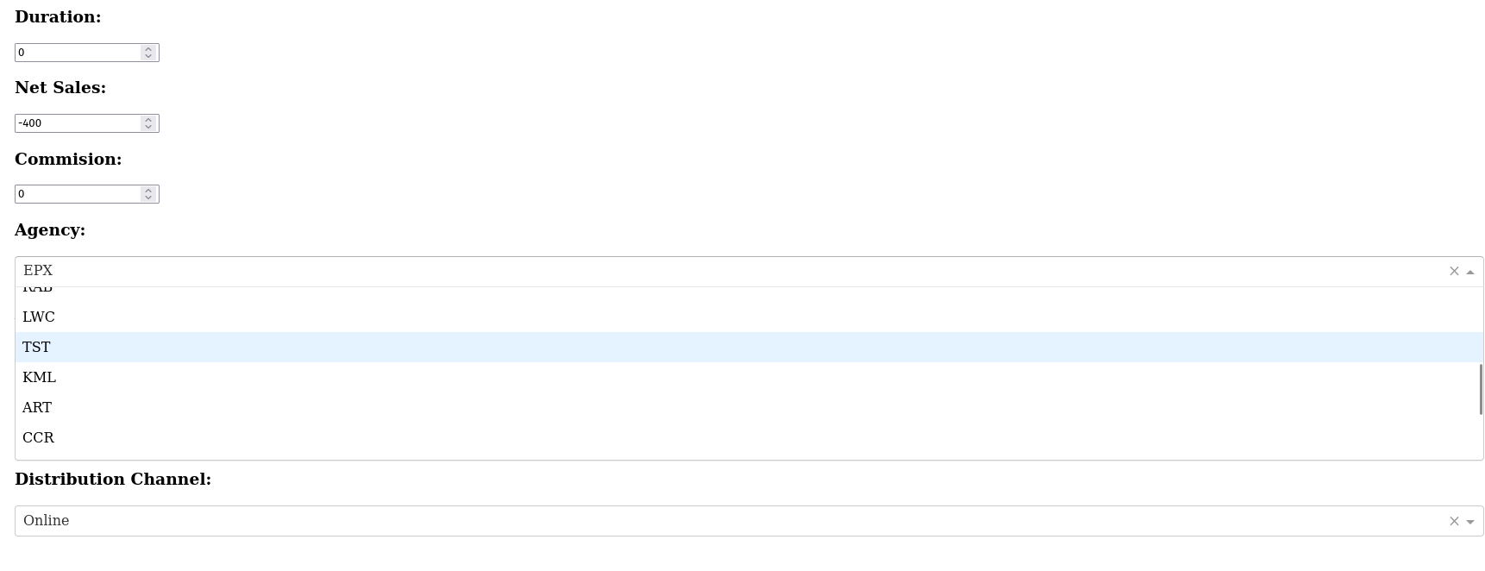
App Created
App set to default
App at work

Slide 7
Conclusion
We were able to create the app but I do not understand why it does not display the results of the model. You can see that the categories are present to predict the claim but no prediction is ever displayed. I did try troubleshooting to figure out why it was not working but nothing I tried worked to bring it up.

